Slide 1

Air pollution
Group : 13
Student : Tony, Andy
PEC AI
Course
2019

Slide 2
TEAM
01

Slide 3


Member
Tony
Andy
Master of Electrical Engineering
Master of Electrical Engineering

Slide 4
Data Preprocessing
02

Slide 5
What’s the data ?
Data – Kaggle [Air quality in northern Taiwan]
23 pollution features at specific time at specific location
For example : CO, No, O3, PM10, PM2.5 ….
23 features
Time | Station | CO2 | No | O3 | … | PM10 | PM2.5
2015/1/1 00:00 | Banqiao | 0.79 | 1.2 | 37 | … | 45 | 25
2015/3/30 13:00 | Dayuan | 0.8 | 1.3 | 38 | … | 144 | 20
2015/10/29 04:00 | Songshan | 0.6 | 2.4 | 21 | … | 38 | 19
Different Place
&
Different Time
Records :218640

Slide 6
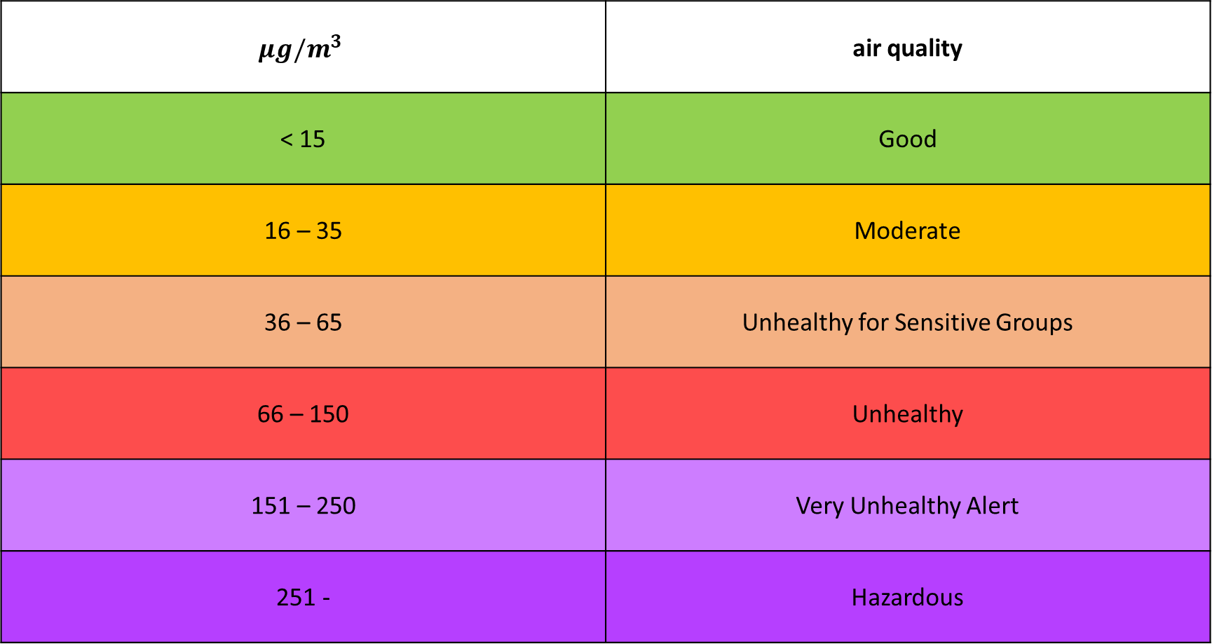
Concentrations of fine particulate matter
$$μg/m^{3}$$ | air quality
< 15 | Good
16 – 35 | Moderate
36 – 65 | Unhealthy for Sensitive Groups
66 – 150 | Unhealthy
151 – 250 | Very Unhealthy Alert
251 - | Hazardous

Slide 7
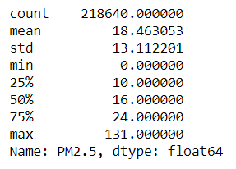
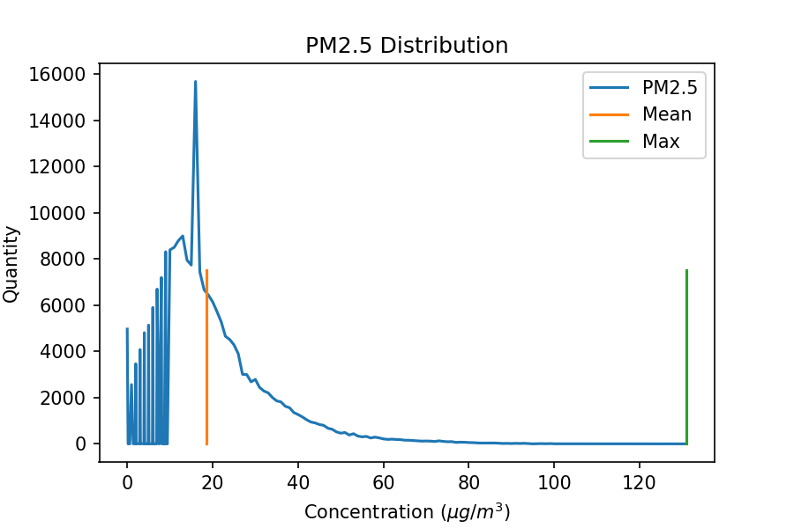

Slide 8
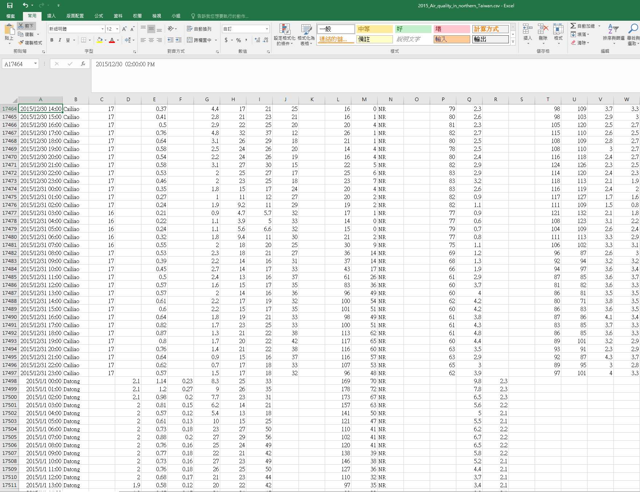
Data Set

Slide 9
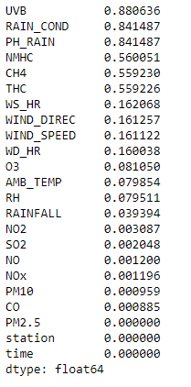
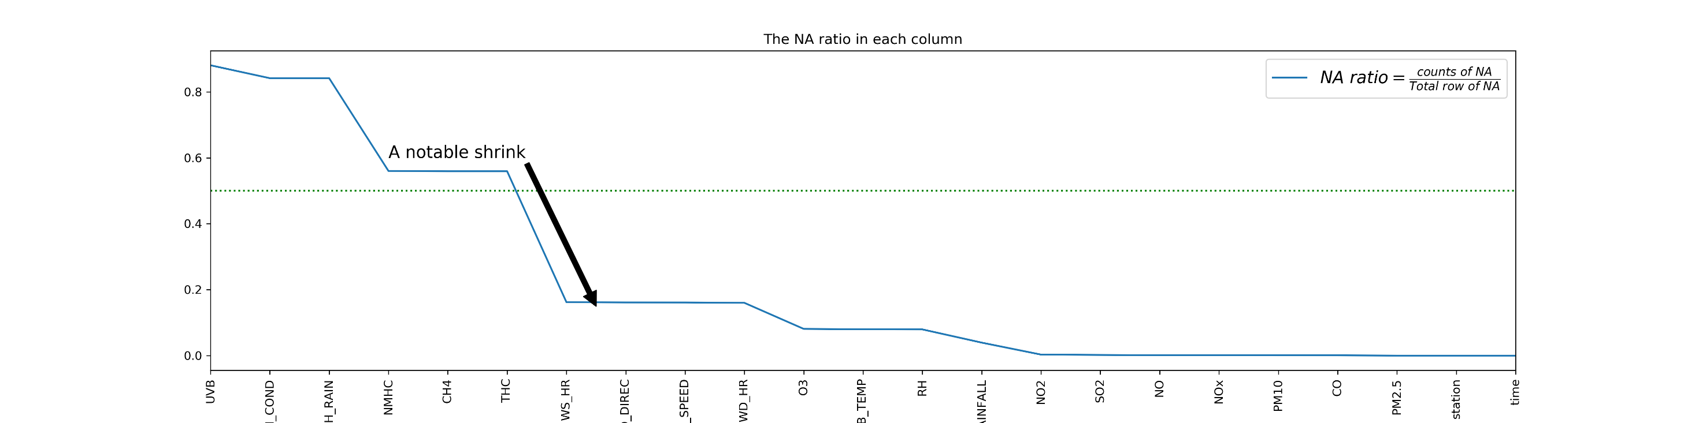
NA Ratio Problem
Our dataset has many null values, so we need to find what the feature is invalid.

Slide 10
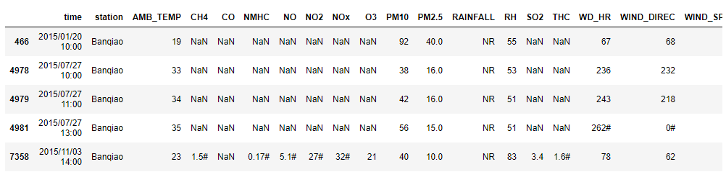
NA Ratio Problem
We choice the less NA feature(CO), so we can find if CO is NA , other feature will be NA
7 NA Value

Slide 11
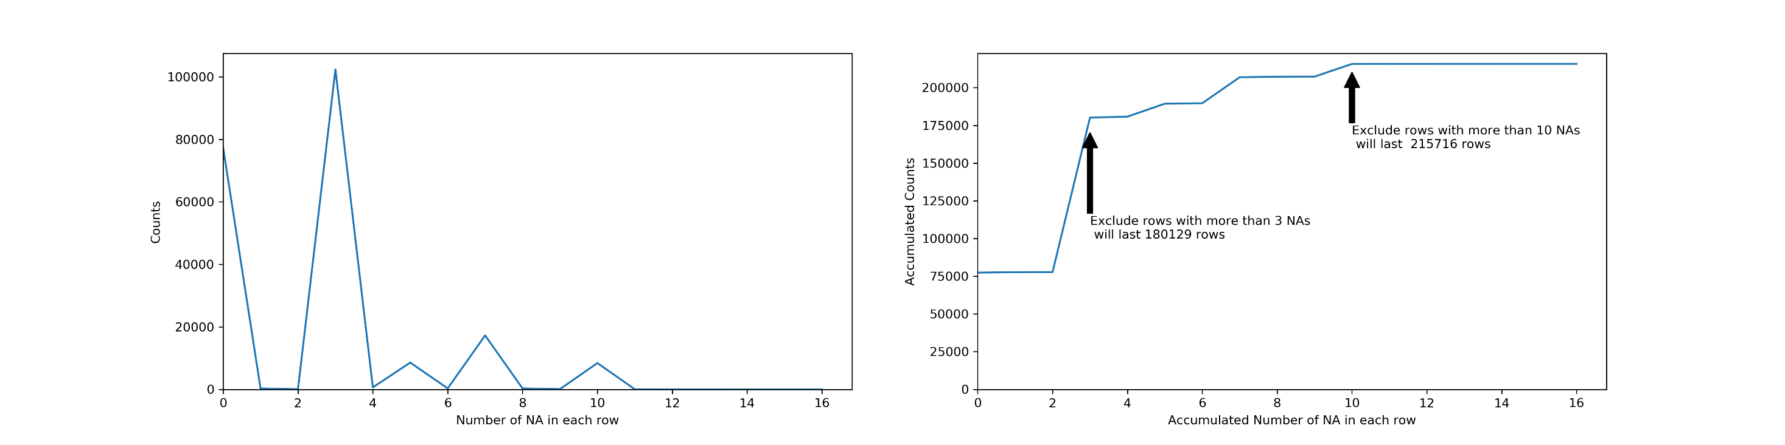
NA Ratio Problem

Slide 12
NA Ratio Problem
Discuss another over 0.5 NA ratio
NMHC : mean Non-Methane Hydrocarbon
CH4 : Methane
THC : Total Hydrocarbons
→TCH = CH4 + NMHC

Slide 13
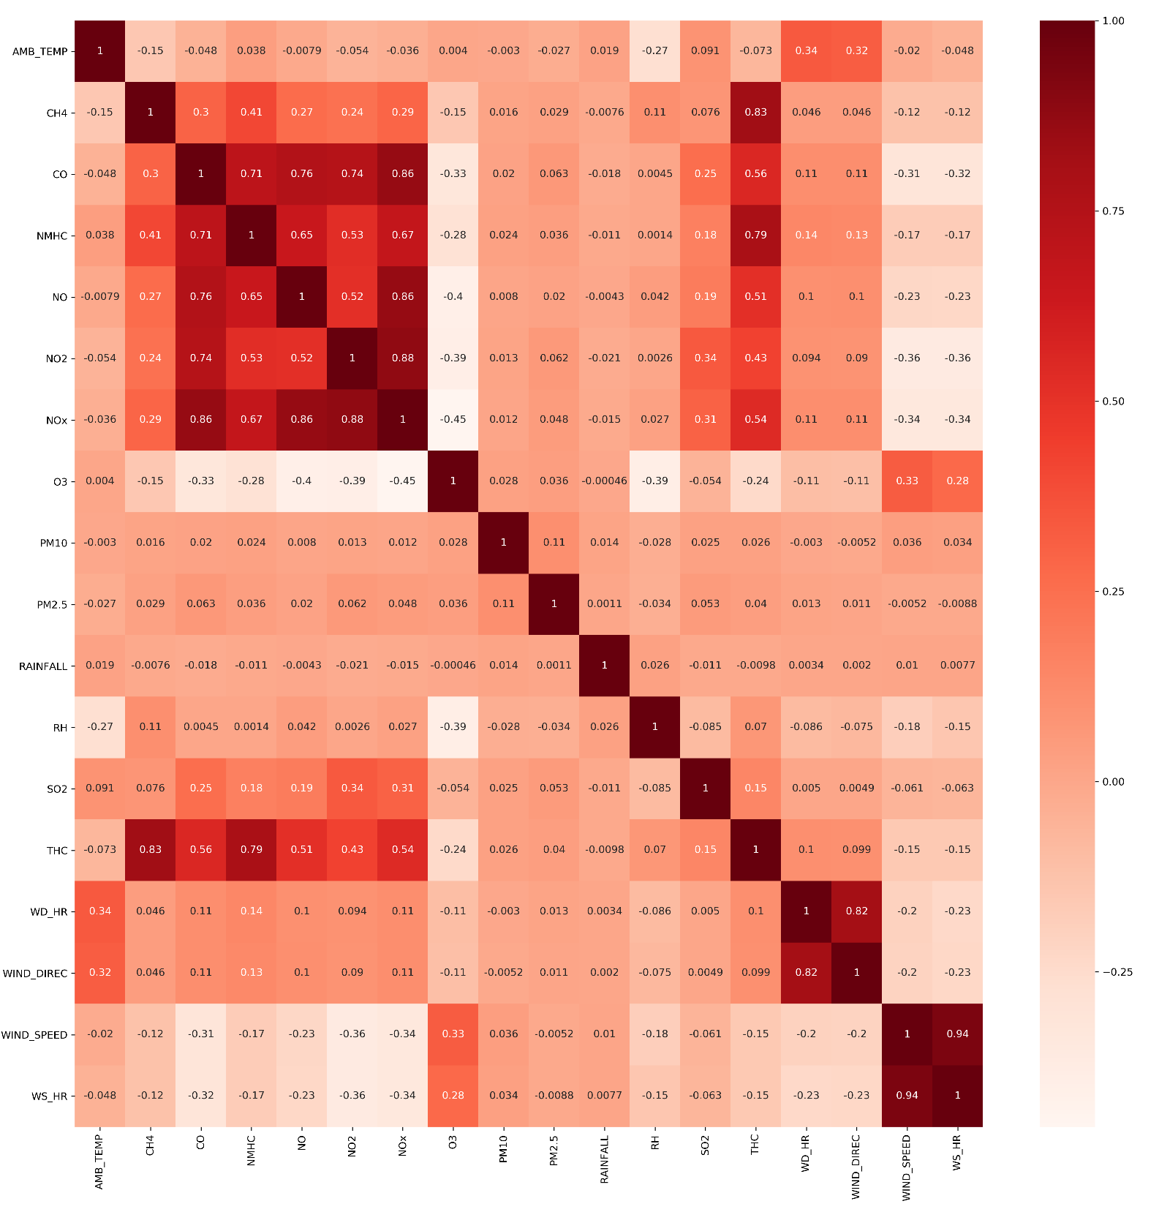

Slide 14
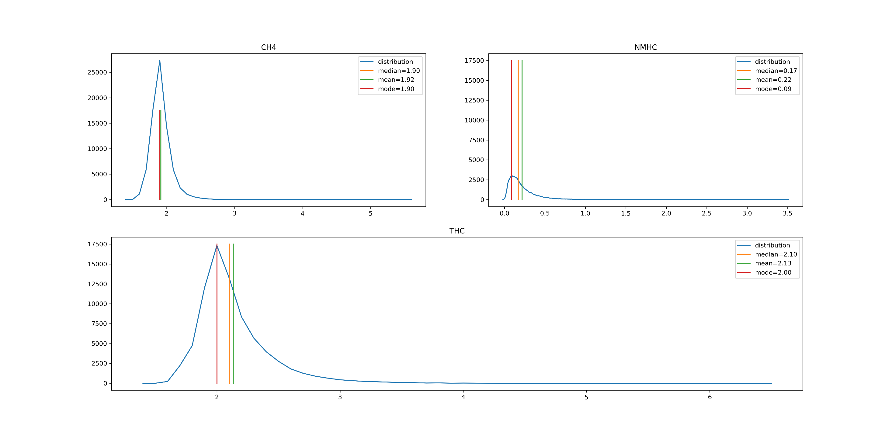
NA Ratio Problem

Slide 15
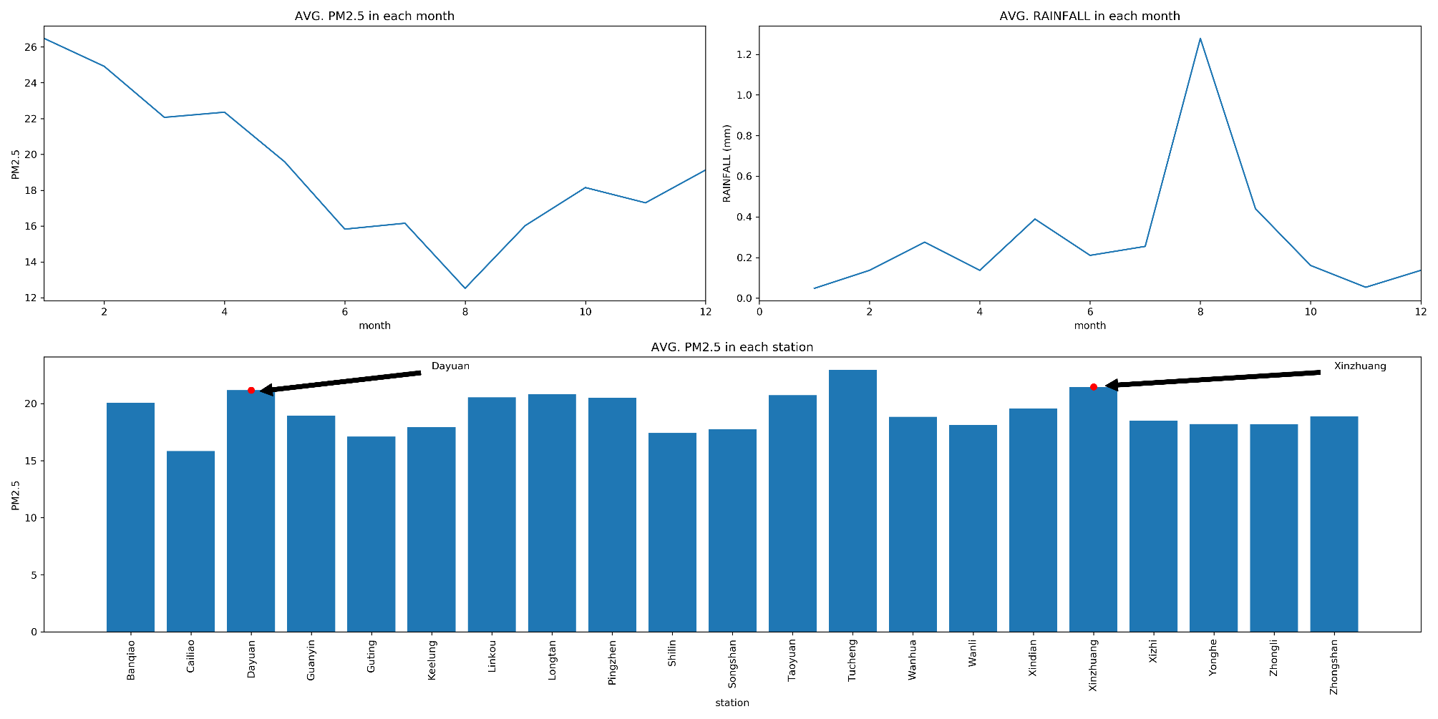
Data Visualization
In 2005, the air pollution in Xinzhuang and Dayuan Town was serious.

Slide 16
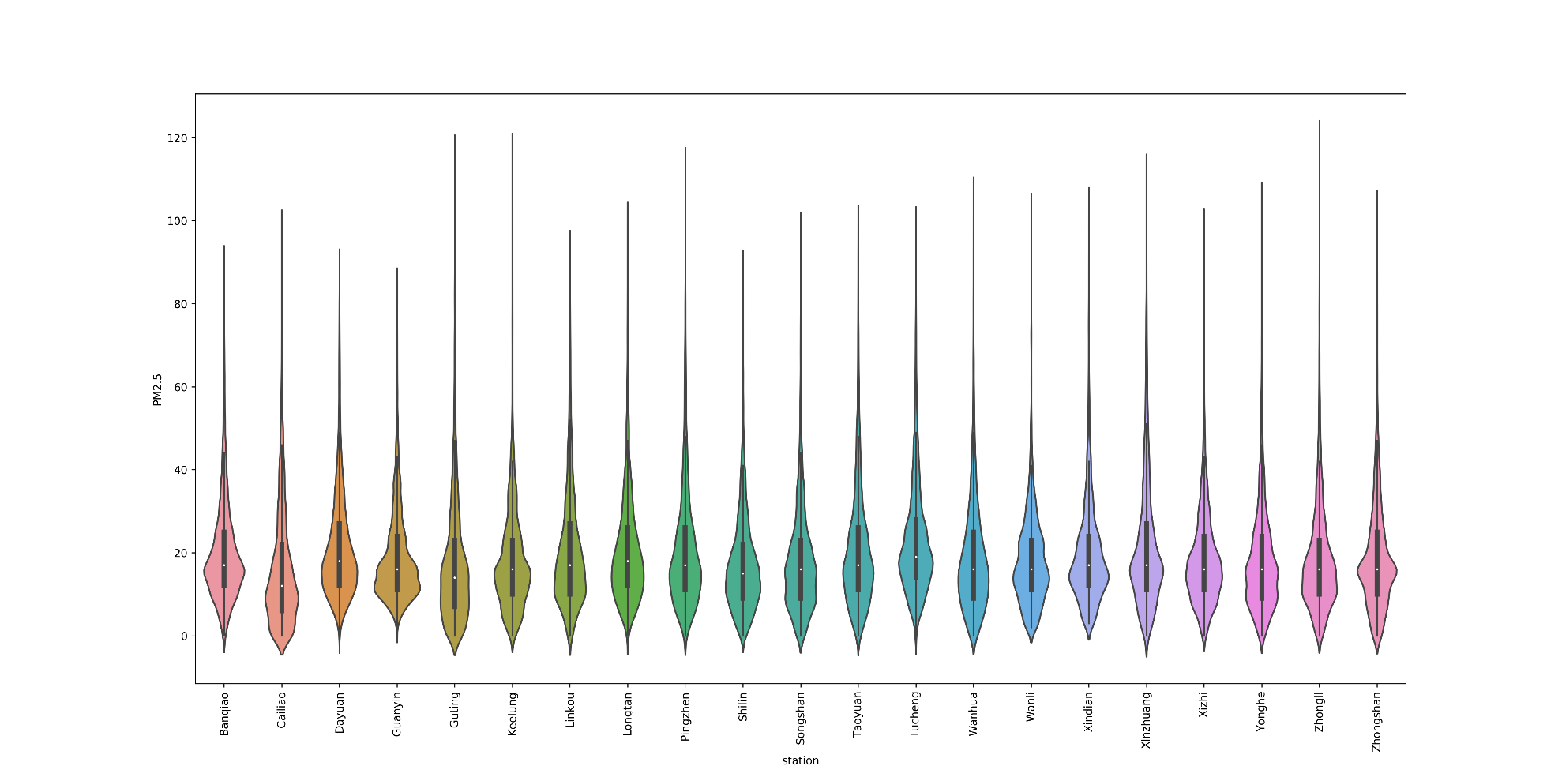
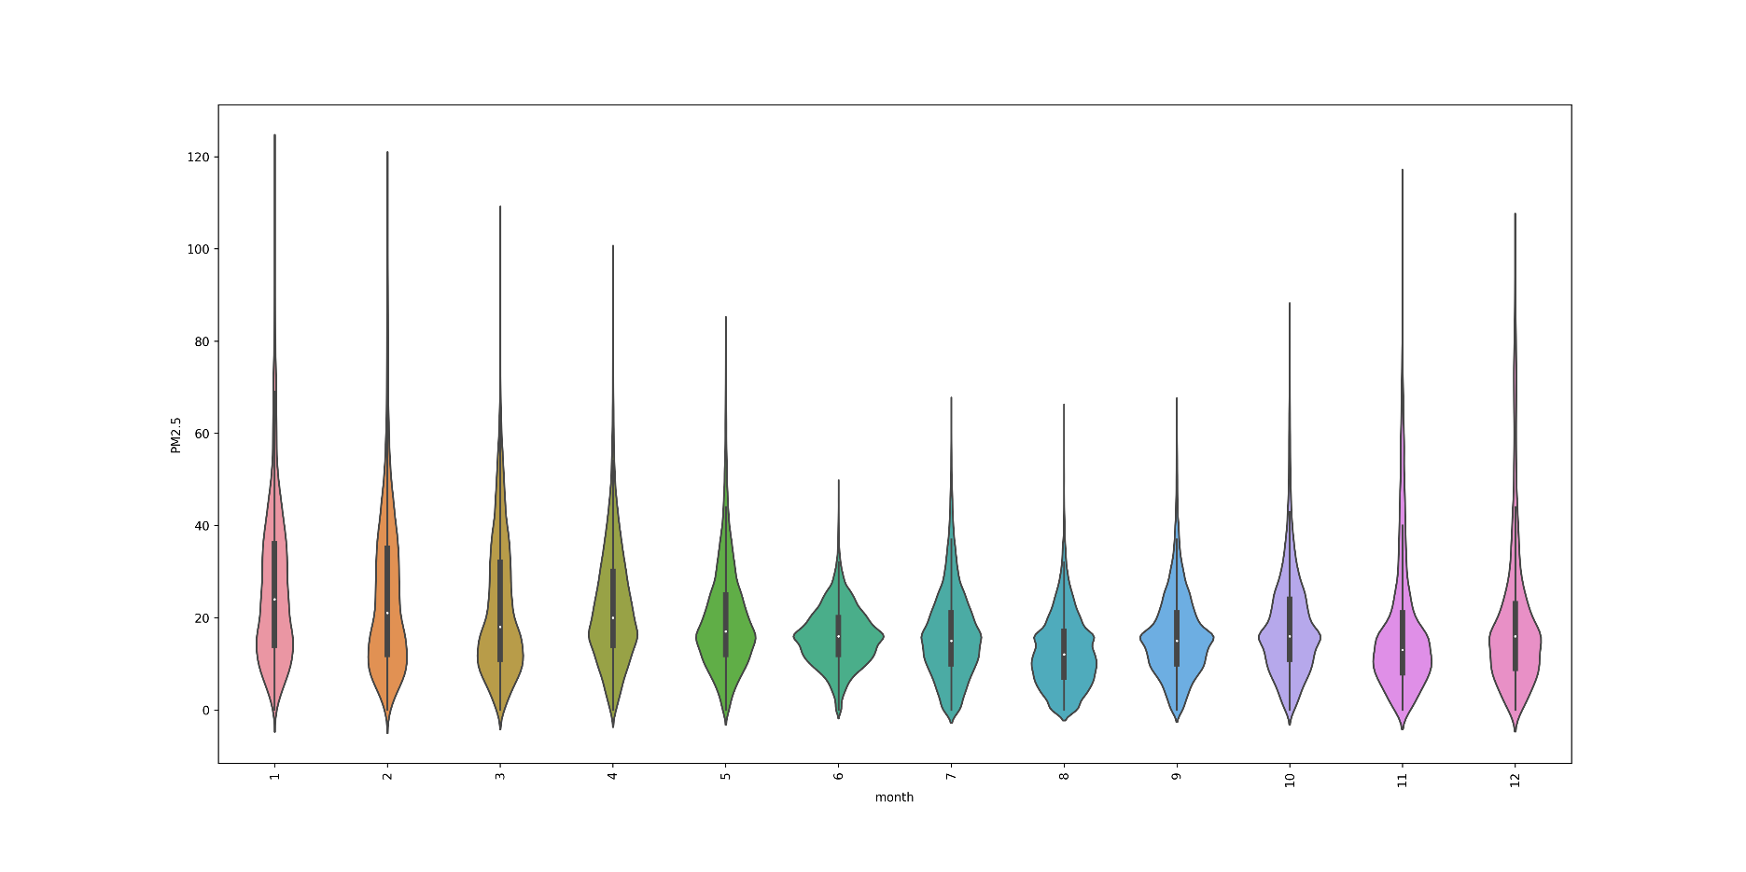

Slide 17
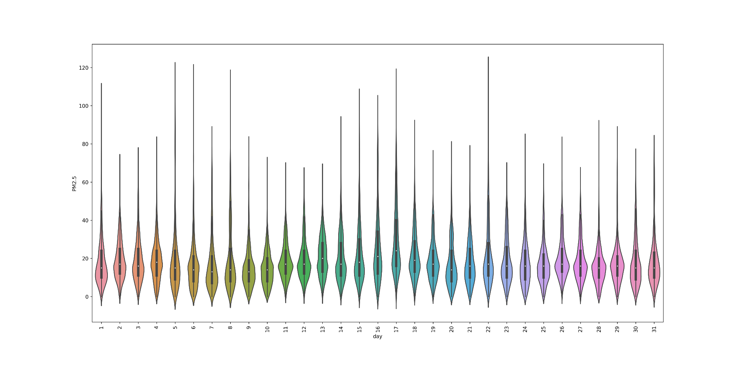
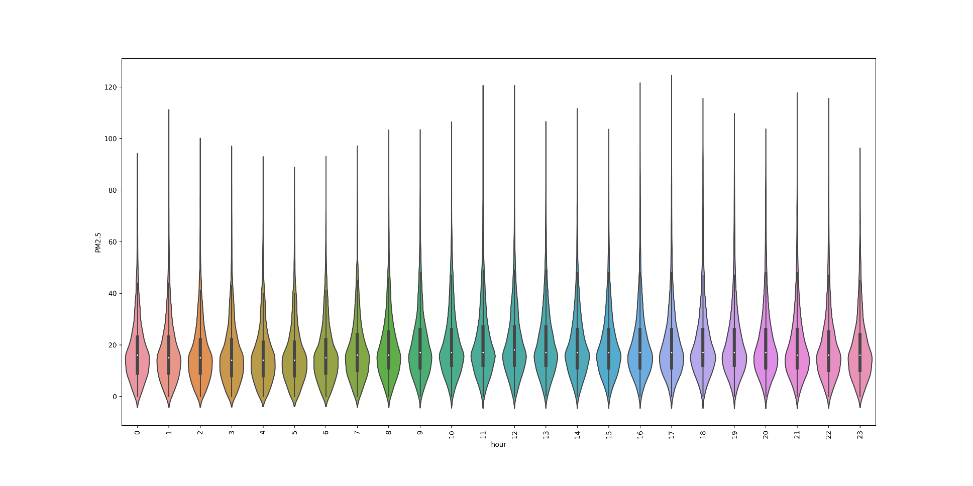

Slide 18
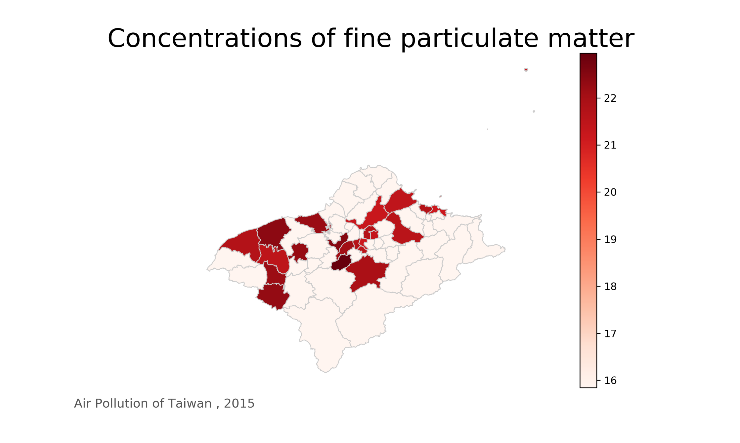
Data Visualization

Slide 19
Training
03

Slide 20
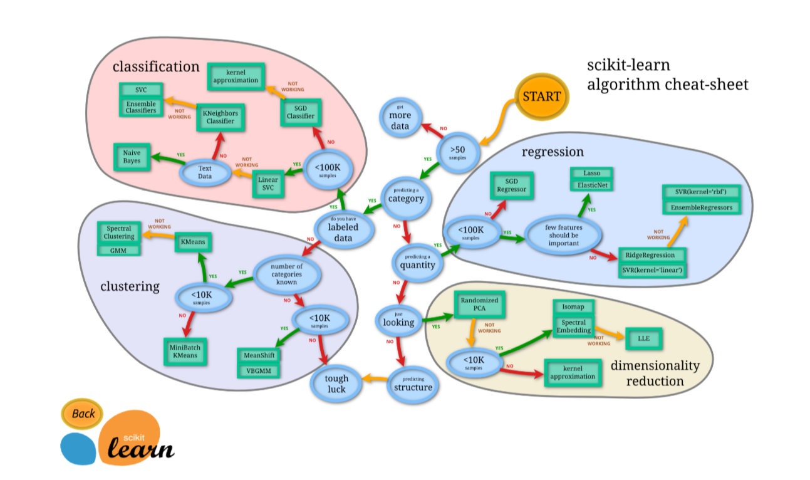

Slide 21
Train data =1-10 months
Test data =11&12 months
Models=SVR
MSE=MeanSquareError

Slide 22
 | Banqiao | Cailiao | Dayuan | Guanyin | Guting | Keelung | Linkou | Longtan | Pingzhen
Train | 7283 | 7121 | 6630 | 7081 | 7250 | 7278 | 6978 | 7159 | 7193
Test | 1464 | 1445 | 1425 | 1443 | 1460 | 1432 | 1419 | 1453 | 1448
 | Shilin | Songshan | Taoyuan | Tucheng | Wanhua | Wanli | Xindian | Xinzhuang | Xizhi
Train | 7124 | 7265 | 7237 | 7208 | 7215 | 7177 | 7205 | 7133 | 7040
Test | 1453 | 1456 | 1463 | 1464 | 1450 | 1445 | 1439 | 1499 | 1441
 | Yonghe | Zhongli | Zhongshan
Train | 7287 | 7267 | 7244
Test | 1461 | 1459 | 1462

Slide 23
Prediction
04

Slide 24
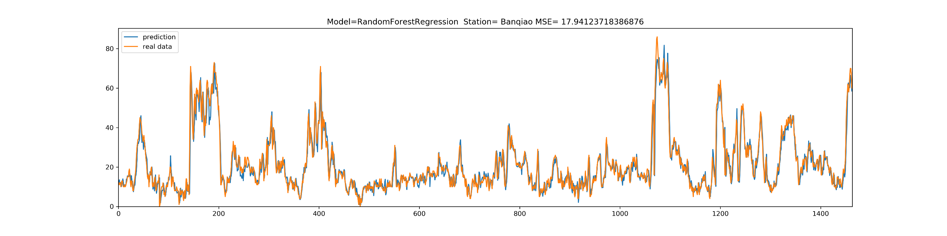
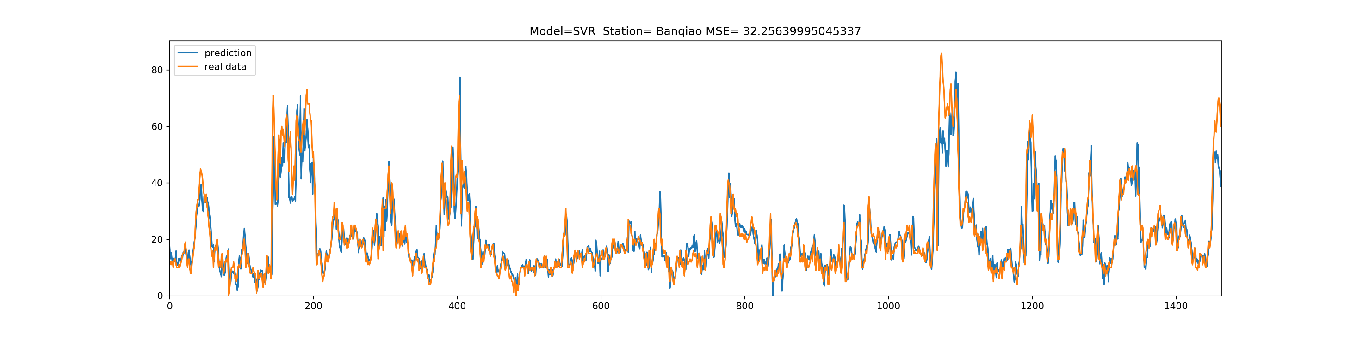

Slide 25
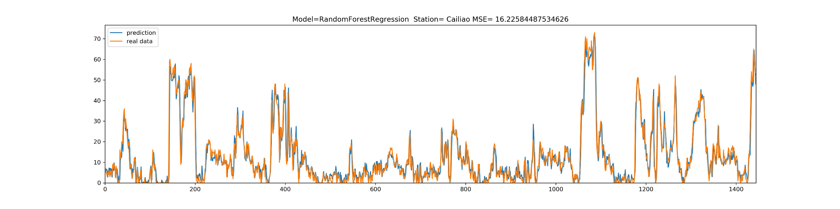
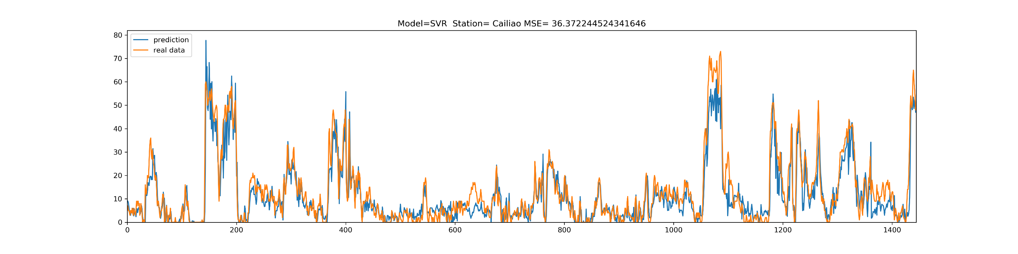

Slide 26
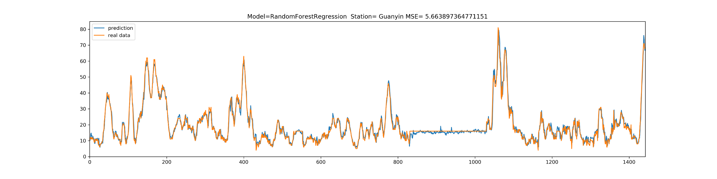
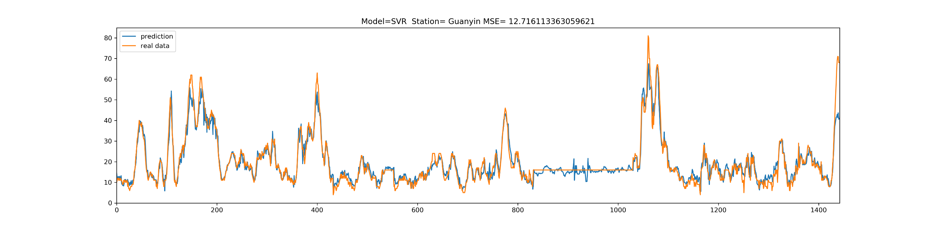

Slide 27
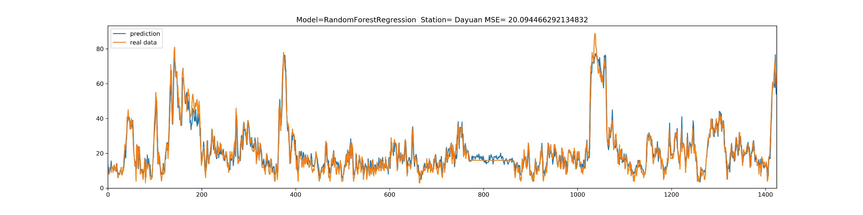
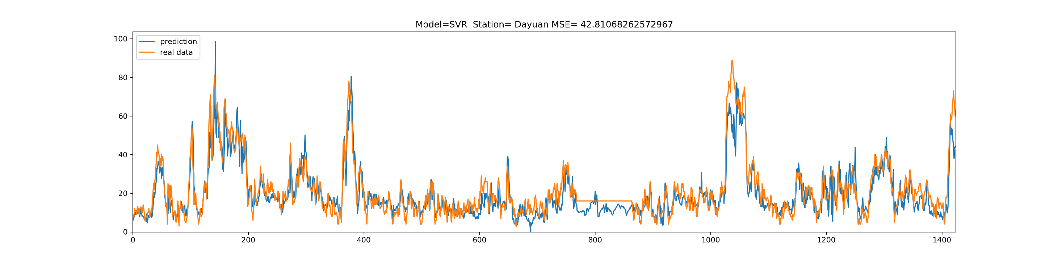

Slide 28
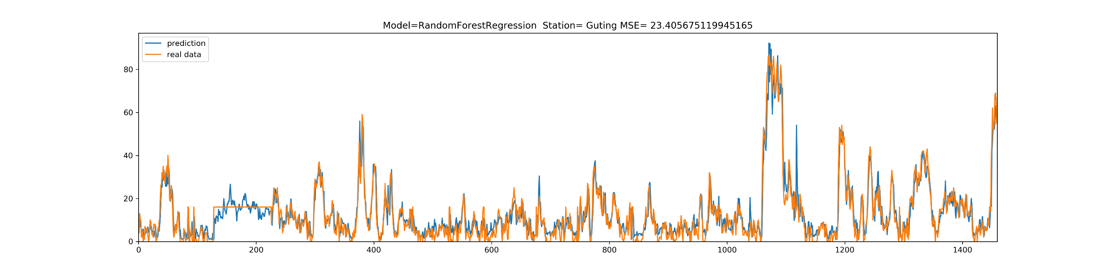
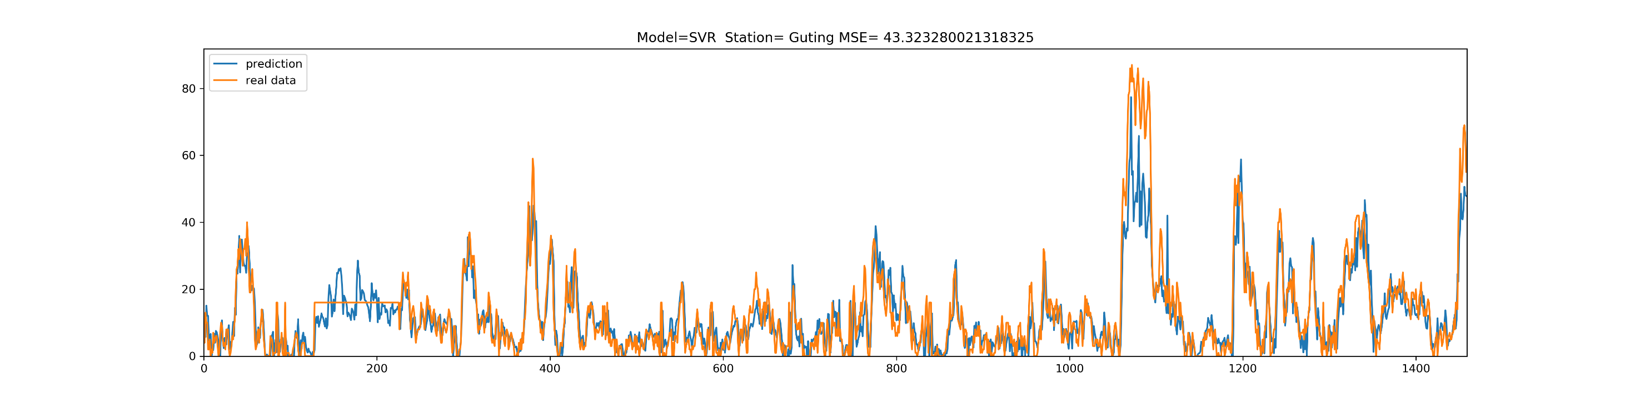

Slide 29
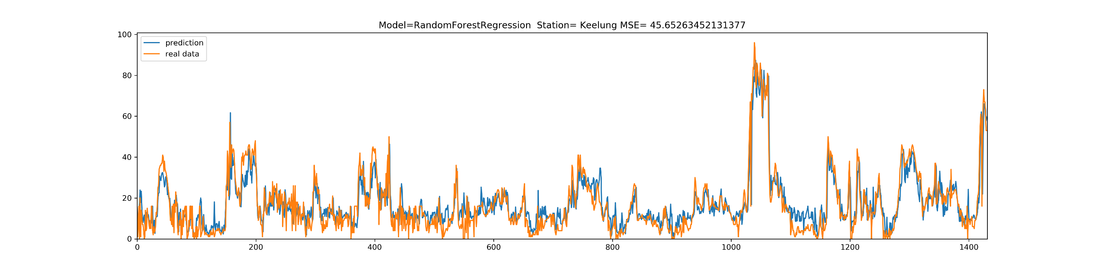
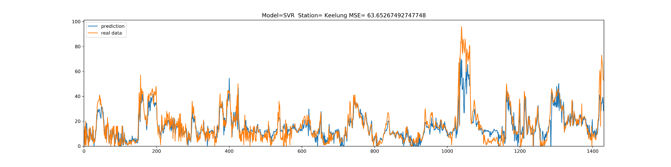

Slide 30
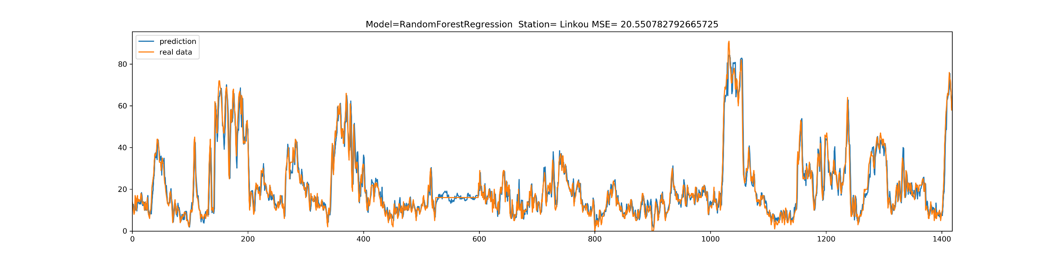
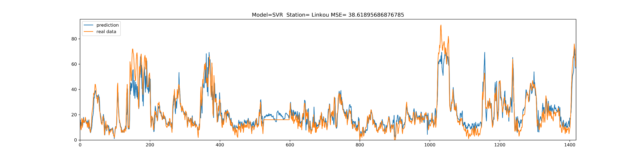

Slide 31
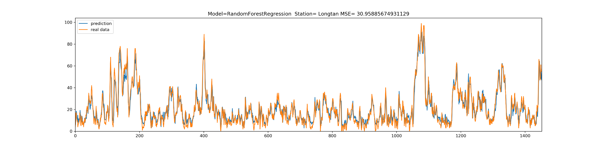
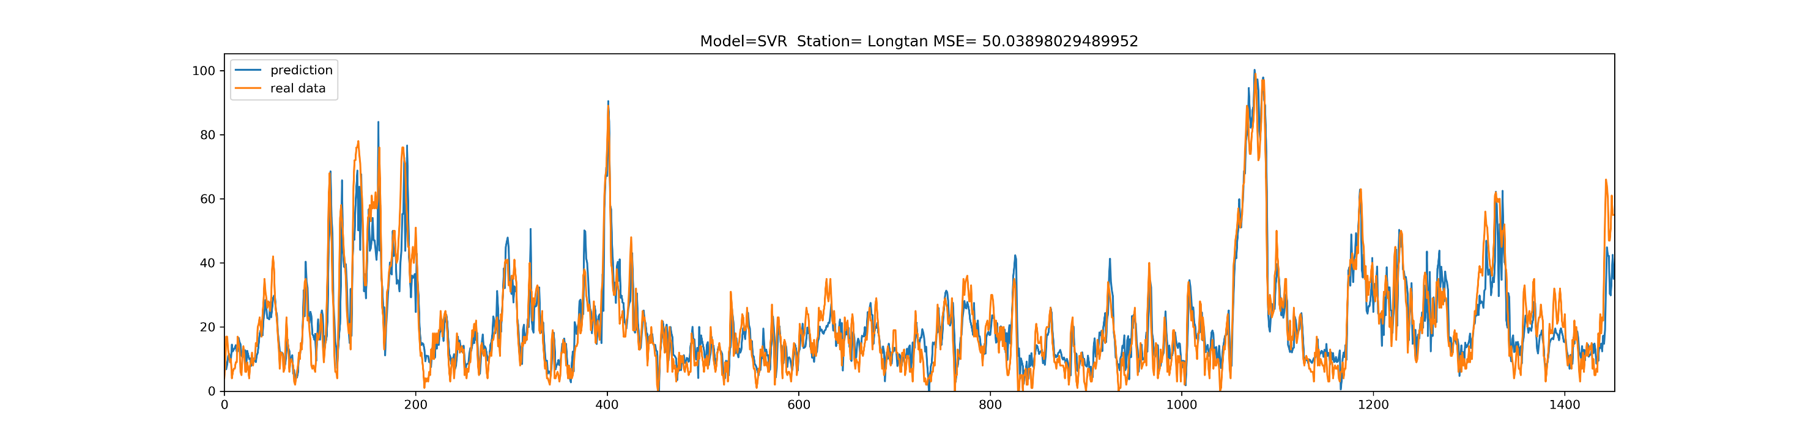

Slide 32
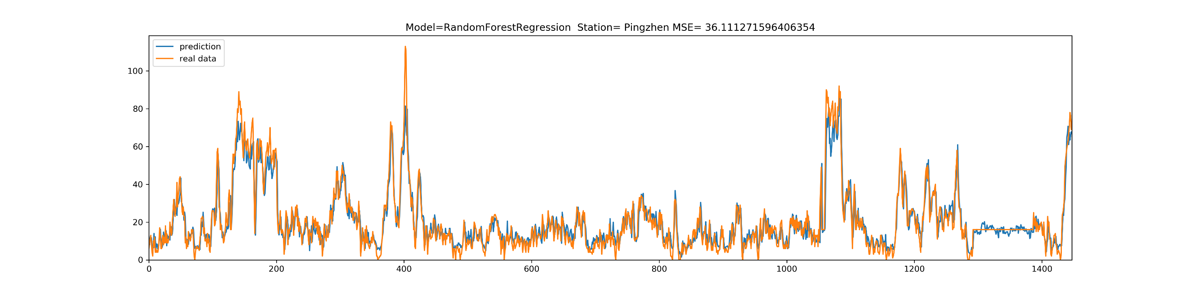
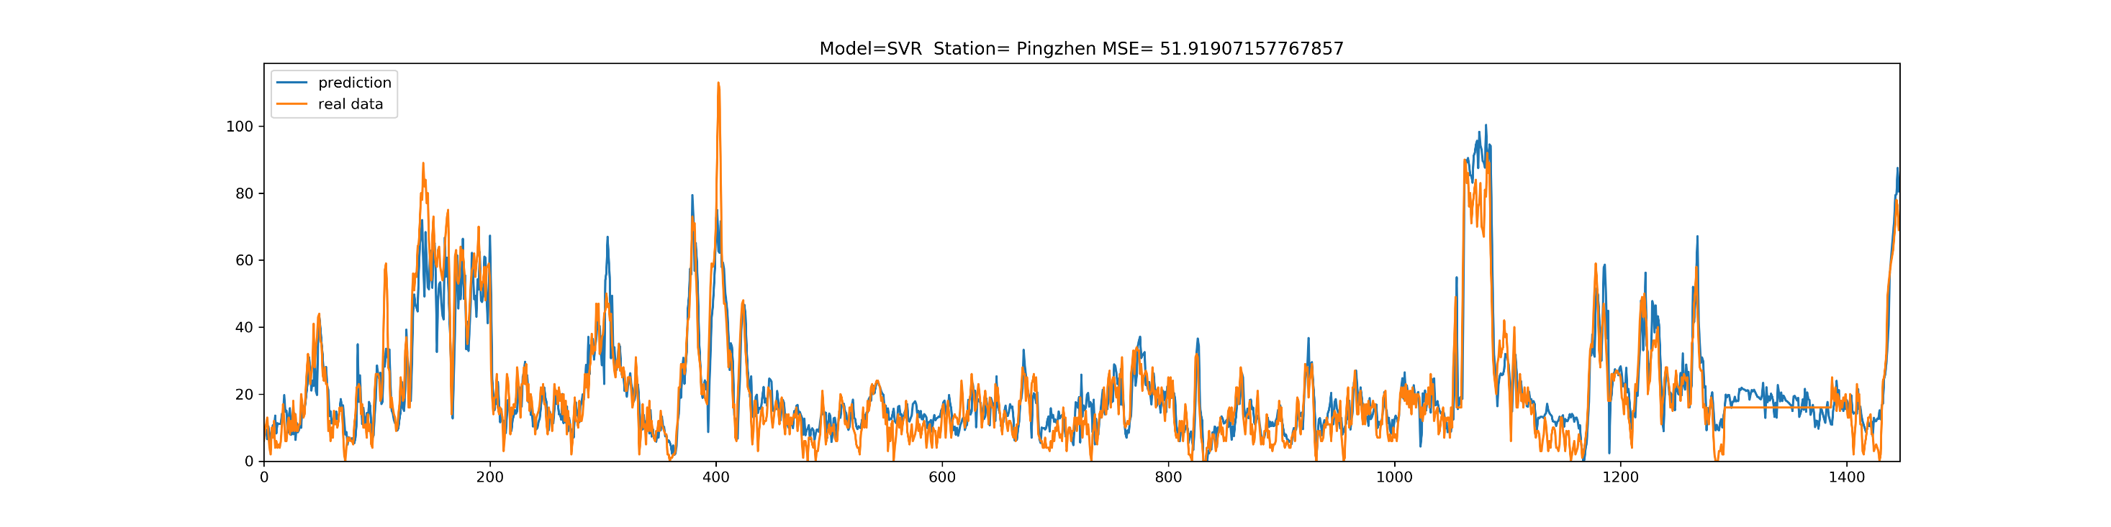

Slide 33
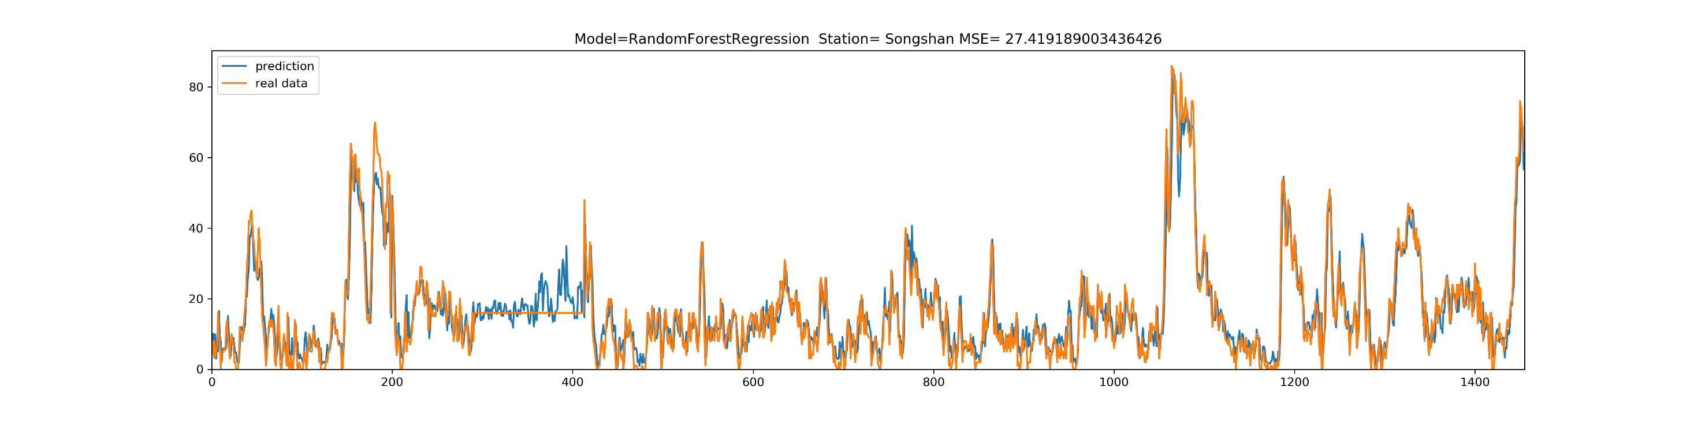
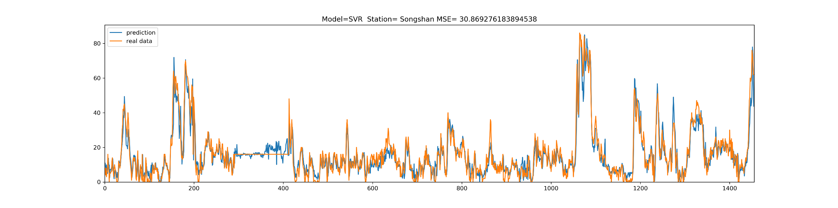

Slide 34
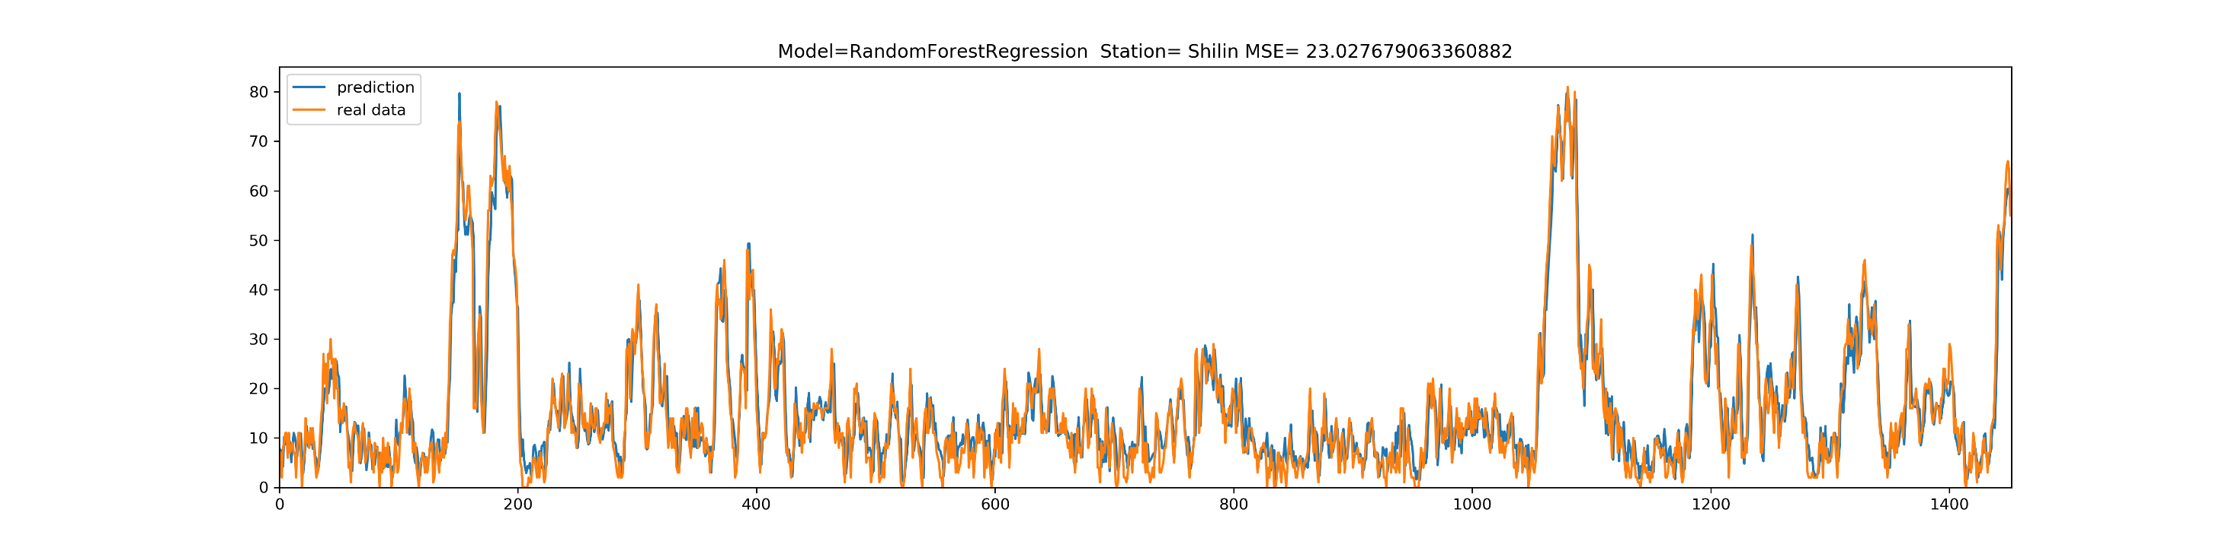
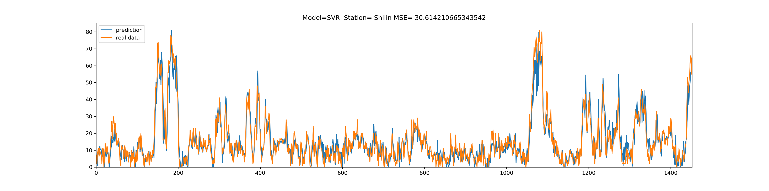

Slide 35
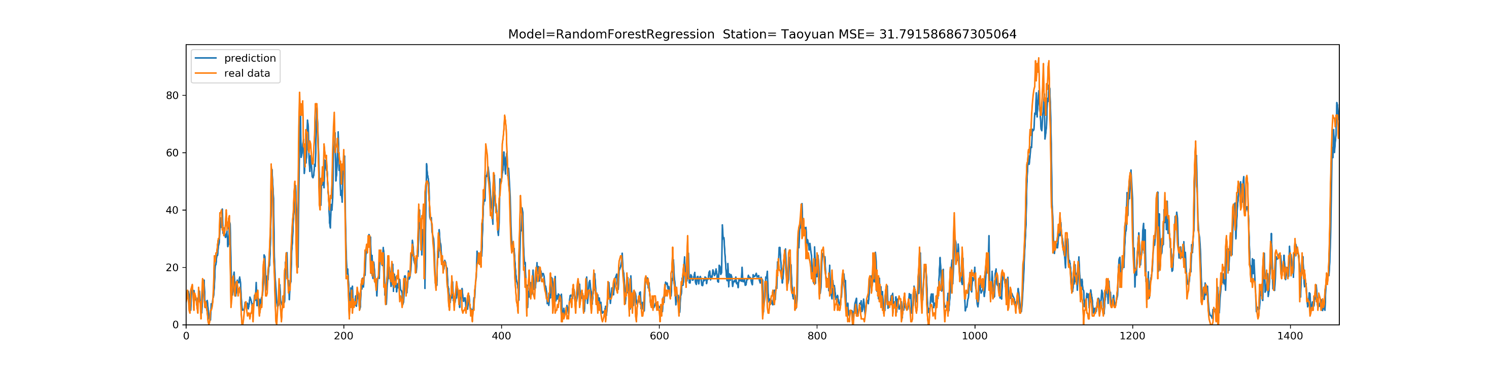
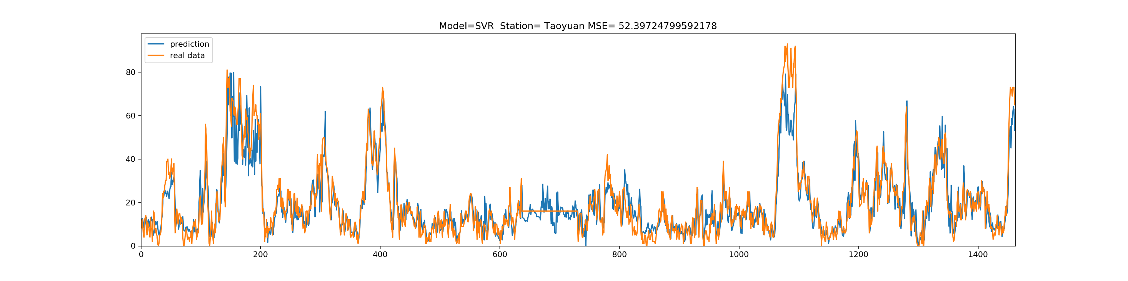

Slide 36
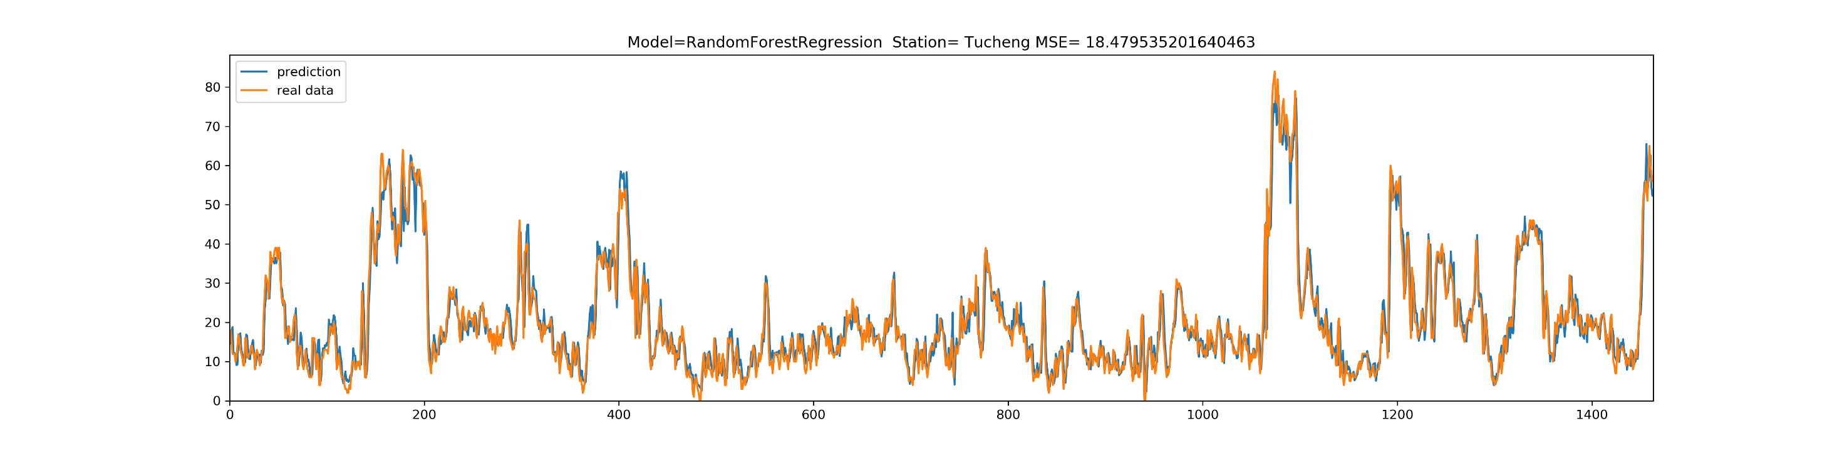
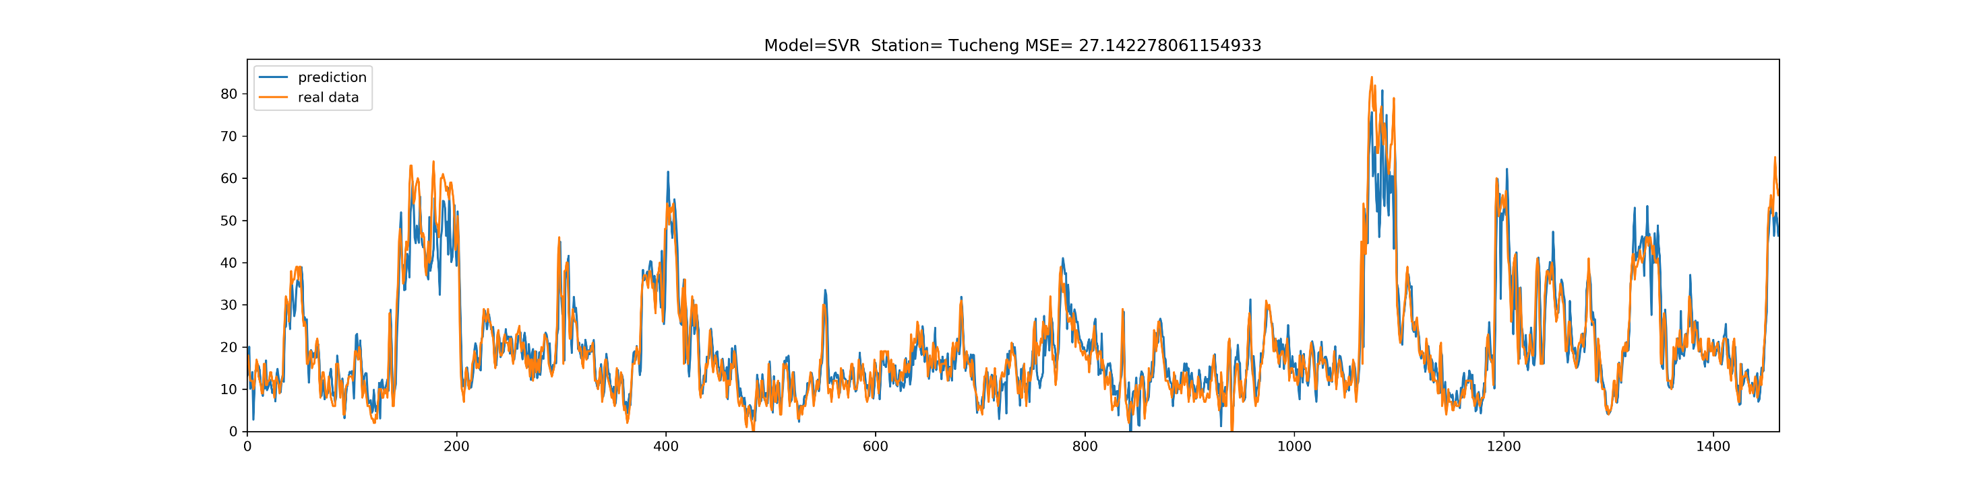

Slide 37
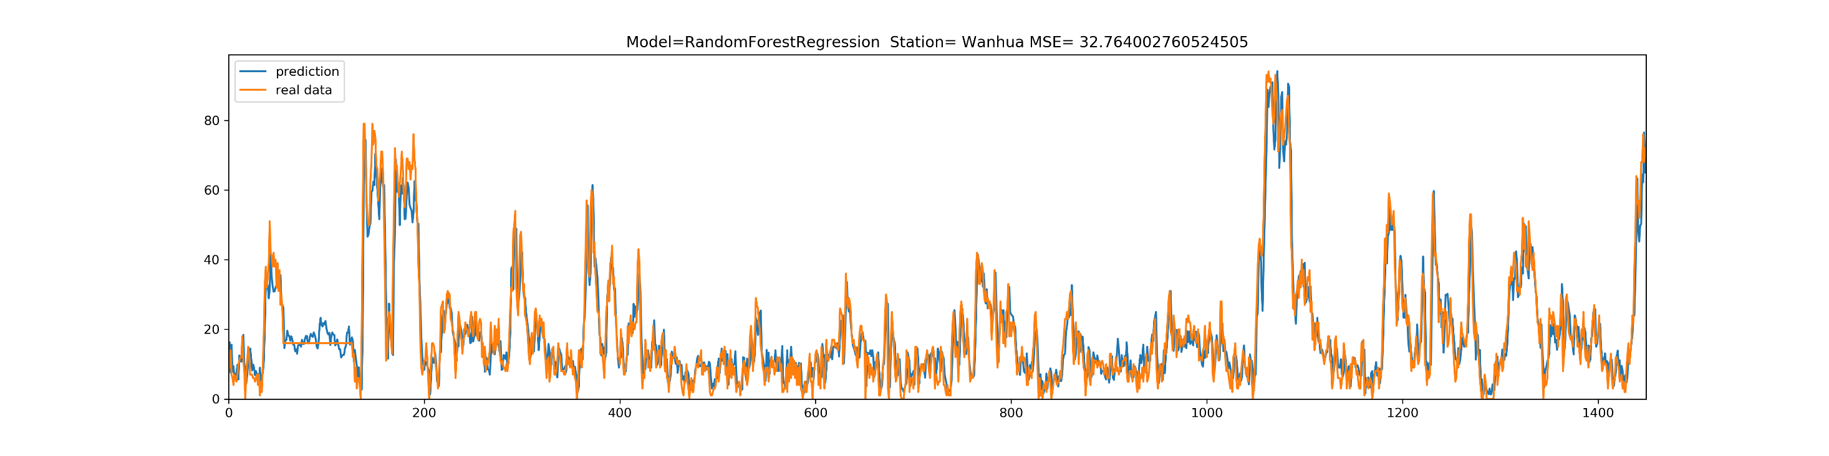
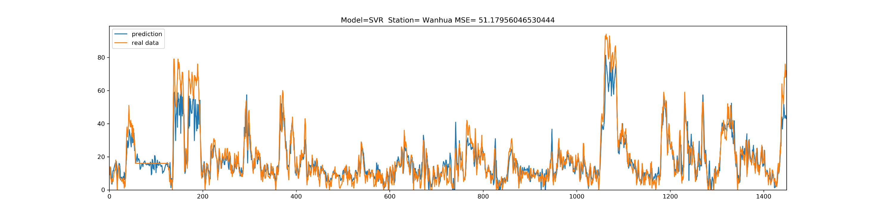

Slide 38
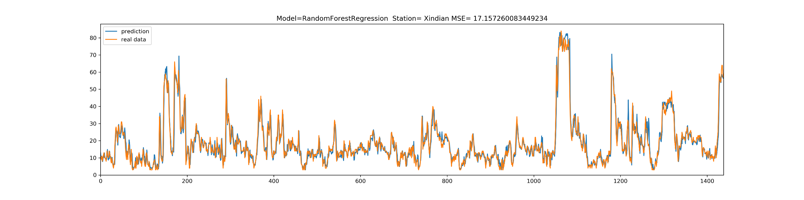
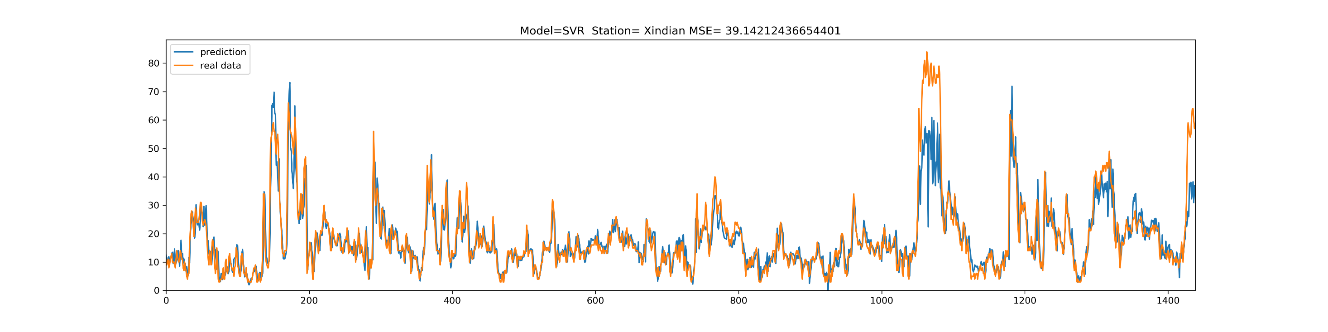

Slide 39
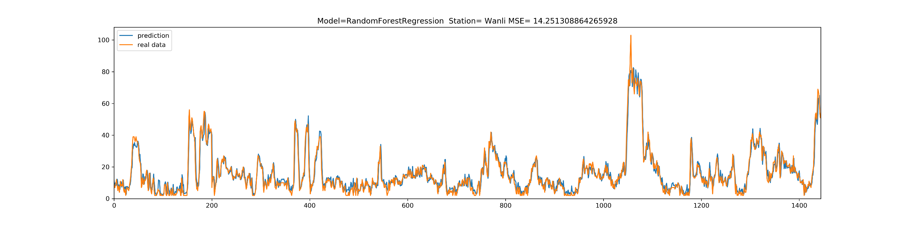
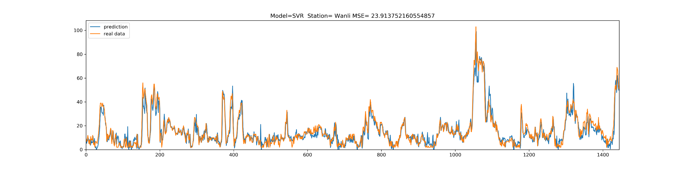

Slide 40
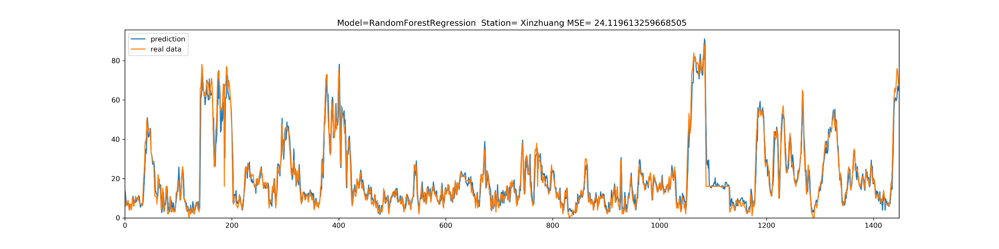


Slide 41



Slide 42



Slide 43



Slide 44



Slide 45
 | RandomForestRegression | SVR
AVG MSE | 24.19 | 40.126
Time | <1s | 39.9s

Slide 46
Thanks

